Slide 1


Interactive Tool for Visualizing Marks Distribution in a Class
PRESENTED BY
2303811714821058 – B.R.VIMAL AANANTH

Slide 2

PRESENTATION OVERVIEW
Objective
Problem Statement
Existing System and its Drawback
Proposed System and it’s Advantages
Block Diagram
Dataflow Diagram
Modules Split up
Modules Explanation
Screenshots
Conclusion

Slide 3
OBJECTIVE
To develop an interactive tool using R that enables efficient analysis and visualization of student marks distribution. This tool helps educators and students:
Understand academic performance.
Use statistical metrics like mean, median, standard deviation, percentiles.
Interact through visual tools such as histograms, box plots, and graphs.

Slide 4
PROBLEM STATEMENT
In academic institutions, analyzing student performance through traditional methods is time-consuming and lacks interactivity. Teachers need an efficient way to visualize marks distribution, identify patterns, and make data-driven decisions. This tool will provide an easy-to-use interface to:
Load student marks data
Compute statistical measures (mean, median, percentiles, standard deviation)
Generate interactive histograms, box plots, and tables
Allow real-time filtering and comparisons

Slide 5
EXISTING SYSTEM AND ITS DRAWBACK
Existing Method:
In many institutions, student marks are handled using Excel, paper records, or desktop tools. Data entry, chart creation, and calculations are done manually.
There is no centralized access or real-time updates, making the process slow, repetitive, and hard to collaborate on. Manual Excel sheets or desktop-based tools.
Limitations:
No automated analysis or interactive data exploration.
Only static charts with limited filtering or export options.
Lacks live updates, custom filters, and graphical storytelling needed for modern education decisions.

Slide 6
PROPOSED SYSTEM AND IT’S ADVANTAGES
The proposed system is a web-based tool developed using R technologies such as Shiny, ggplot2, plotly, and dplyr. It offers an accessible platform for educators to analyze student data without needing programming skills.
Users can upload student marks in various formats, enabling seamless data input. The system performs real-time statistical analysis, calculating key metrics like mean, median, standard deviation, and percentiles automatically to provide immediate insights.
It generates interactive visualizations such as histograms and box plots that help in understanding performance distributions clearly.
Summary reports can be easily exported for further use or sharing.

Slide 7
PROPOSED SYSTEM AND IT’S ADVANTAGES
ADVANTAGES:
Interactive filtering options.
Automated calculations.
Clear performance insights.
User-friendly interface.
No technical skills needed.
Efficient decision-making.
Accessible anytime, anywhere.

Slide 8
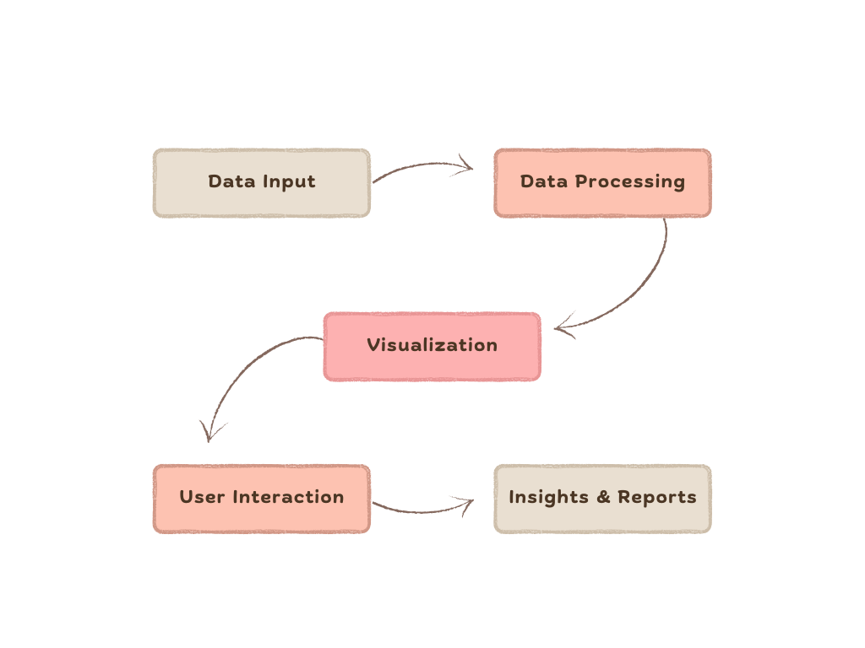
BLOCK DIAGRAM

Slide 9
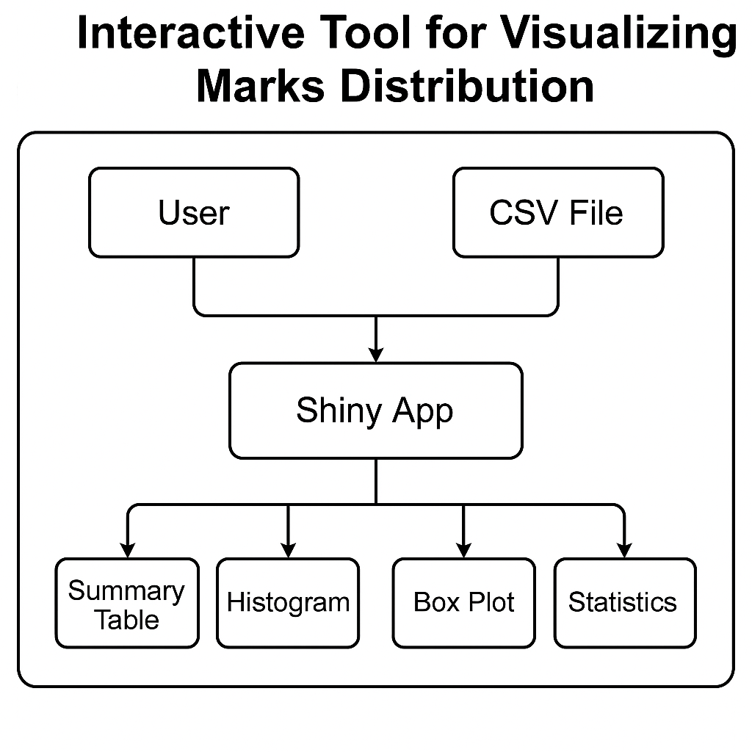
DATAFLOW DIAGRAM

Slide 10
MODULES SPLIT UP
Data Loading & Preprocessing
Statistical Analysis
Visualization (Graphs and Charts)
Interactive Dashboard (Shiny App)
Report Generation & Export

Slide 11
MODULES EXPLANATION
Data Loading & Preprocessing:
Upload CSV/Excel files
Use dplyr for structured manipulation
Statistical Analysis:
Calculate: Mean, Median, Mode, Std Deviation, Percentiles
Identify top performers and low scorers
Data Visualization:
Generate histograms, bar charts, and box plots
Use ggplot2 for static and plotly for interactive plots

Slide 12
MODULES EXPLANATION
Interactive Dashboard:
Developed using R Shiny
Real-time filters by subject, student, range
Instant graph updates upon input change
Report Generation:
Export charts and summaries to PDF/HTML
Provide download options for visual content

Slide 13
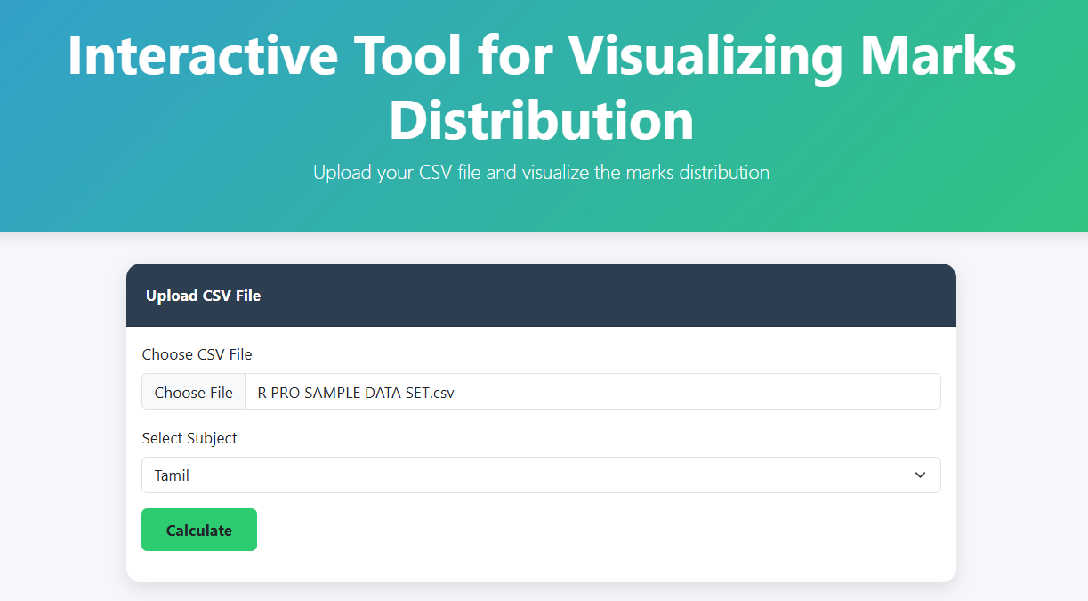
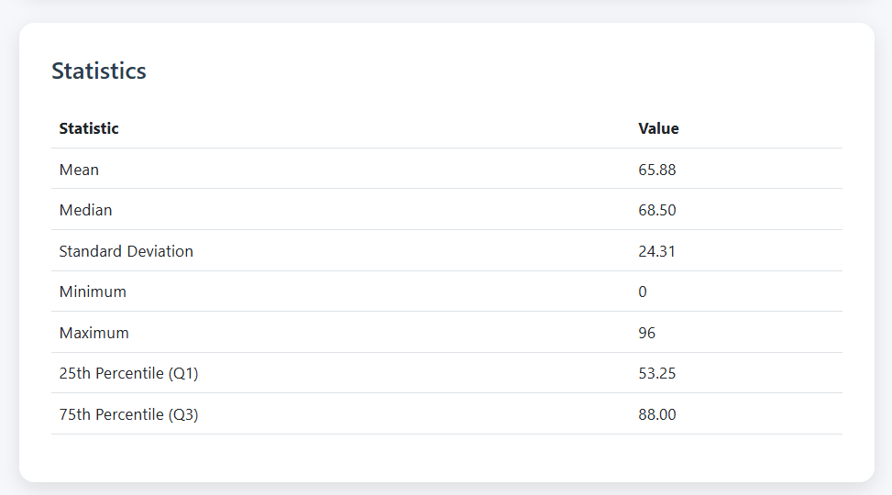
SCREENSHOTS
DATA LOADING & PREPROCESSING
STATISTICAL ANALYSIS

Slide 14
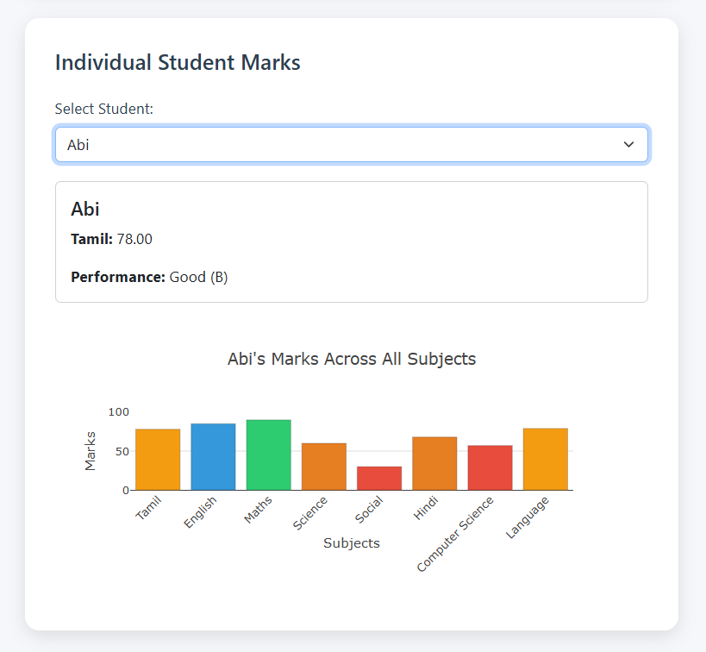
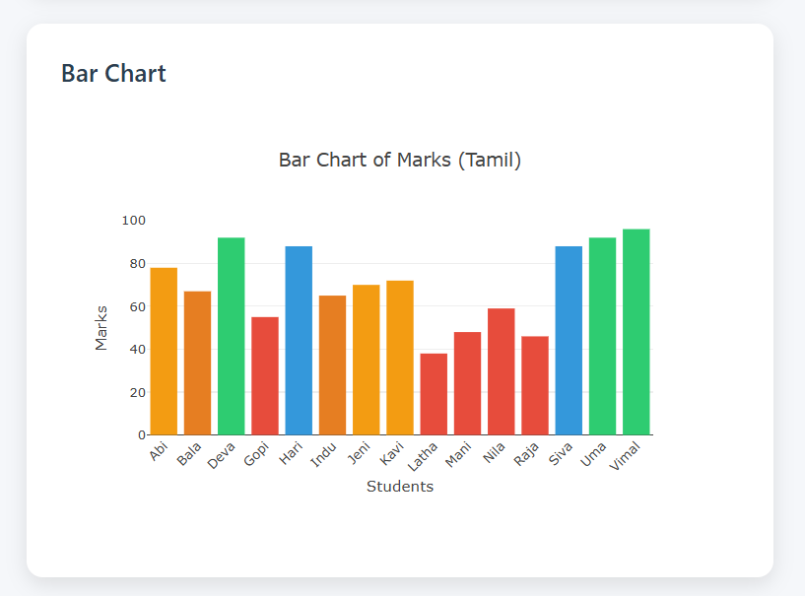
SCREENSHOTS
INTERACTIVE DASHBOARD
REPORT GENERATION

Slide 15
CONCLUSION
The tool successfully integrates statistical analysis and interactive visualization using R, creating a powerful and user-friendly platform for analyzing student marks. By combining tools like Shiny, ggplot2, and plotly, it delivers a seamless experience for academic data interpretation.
It empowers educators to make informed decisions quickly and track student performance effectively.
With dynamic filtering and exportable reports, it bridges the gap between raw data and actionable insight.
This solution transforms traditional marks analysis into a smart, interactive, and efficient process, enabling data-driven education.

Slide 16


